Slide 1

THE FRANCISCAN SPIRITUALITY OF JPIC
Some provocative reflections
by
Andrew Conradi, ofs
National JPIC Animator
National Fraternity of Canada
Ordo Franciscanus Sæcularis
OLOTA Chapter of Elections
Rosemary Heights, Surrey, BC
8 June 2013
Notes:
I have a lot to cover and will be moving fast. I hope to provoke you and that you’ll go away sad, mad and determined to do something.

Slide 2

Thanks to
John Gabor
Animator
CCODP
BC & Yukon Region
for many pictures.

Slide 3
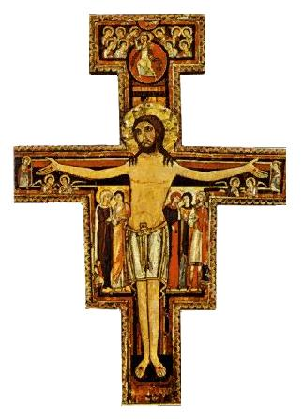
The Prayer before the icon at San Damiano
Most High, glorious God, enlighten the darkness
of my heart
and give me true faith,
certain hope and
perfect charity,
sense and knowledge, Lord,
that I may carry out
Your holy and true command.
Amen
Notes:
There’s a call to action!

Slide 4
Francis was not only a man who prayed, but, as his biographer Thomas of Celano says, he was "a man become prayer”. The presence of God transfigured him until He made him "another Christ".

Slide 5
Francis was also a man of action
Although he is reputed to have said: “Preach - use words if you must,” actually what he wrote in Chapter 17 of the Rule of 1221 was: “All the Friars . . . should preach by their example.” In some translations “example” is rendered as “deeds” or “works.”
Of course, this applies to Secular Franciscans as well!

Slide 6
Understanding JPIC quoting Lester Bach, OFM Cap
Catch me a Rainbow too
“9.2. Bach tells us (1999, 45): “Our call as Franciscans is demanding. We are not called to passive devotions nor fuzzy-friendly fraternity meetings with no content.” JPIC definitely provides serious and important content!”
So expect to be challenged!

Slide 7
JPIC is …
JPIC is the conscious prayer and action to transform the world in the spirit of the Gospel through lives of justice, peace and care for the integrity of creation.
TOR JPIC Promoters

Slide 8
JPIC is part of our DNA
José Rodríguez Carballo, then OFM Minister General*, said the OFM 2003 General Chapter considered: “among the essential elements of our form of life … [are] JPIC as values that form part of what we could well call our Franciscan DNA.” (Fourth European Congress of JPIC Animators, Saint Anna, Poland, 29 April 2010, emphasis added).
Does this apply to the SFO? Remember our Rule?
*Now secretary of the Congregation for Institutes of Consecrated Life and Societies of Apostolic Life.
Michael Perry is now OFM Minister General

Slide 9
The term JPIC came out of the 1983 Sixth World Council of Churches Assembly in Vancouver, BC
There are five bases for OFS commitment to JPIC:
(1) the Bible;
(2) Catholic Social Teaching or Doctrine;
(3) Franciscan spirituality and vision, especially as expressed in the Franciscan Intellectual Tradition as expounded and practiced by the Franciscan Family;
(4) prayer and action;
and, of course, of great importance –
(5) the SFO/OFS Rule and General Constitutions
From gospel to life

Slide 10
Want to learn more?

Slide 12
From gospel to life
“And what does the Lord require of you?
To act justly and to love mercy and to walk humbly with your God.” Micah 6:8
“Your love is for justice; your hatred for evil.” Ps 45
“Blessed are the peacemakers: for they shall be called
the children of God.” Mt 5:9
“The Lord God took man and settled him in the garden of Eden to cultivate and take care of it.” Gen 2:15

Slide 14
JPIC values are values of the Kingdom of God. “The Kingdom of God is Justice, Peace and Joy in the Spirit.” (Rm 14:17). The “Kingdom of God” could be described in contemporary terms as a just world order -- one with compassion, solidarity and the common good at its centre.
Solidarity is not just “a vague feeling of compassion but a firm and persevering determination to commit oneself to the common good …. because we are all really responsible for all.” (Bl JP II)
From Gospel to life

Slide 15
“The word of God itself unambiguously denounces injustices and promotes solidarity and equality. …
It is primarily the task of the lay faithful, formed in the school of the Gospel, to be directly involved in political and social activity”
(Benedict XVI)
Does this mean by our prayer & action we should sanctify the world through JPIC?
Is that one dimension of secularity?
From gospel to lfe

Slide 16
Many of our worldly dealings with others are political and economic
Following are some provocative reflections
on this relationship

Slide 17
CATHOLIC SOCIAL TEACHING
“Foundational Ethical Principles for Business: Human Dignity and the Common Good”
“55. Distribute justly: As creators of wealth and prosperity, businesses… must … make a just distribution of this wealth to employees (following the principle of the right to a just wage), customers (just prices), owners (just returns), suppliers (just prices), and the community (just tax rates).”
(Pontifical Council for Justice and Peace, 2012, Vocation of the Business Leader, A reflection, emphasis added)

Slide 18
Universal Declaration of Human Rights passed by the United Nations General Assembly 10 Dec 1948
“Everyone who works has the right to just and favorable remuneration ensuring for himself and his family an existence worthy of human dignity…” (art 23-3)
Was there a Canadian connection?

Slide 19
John Peter Humphreys
John Peter Humphreys was called upon by the United Nations Secretary-General to work on the project and became the Declaration's principal drafter
He was a Canadian

Slide 20
A key statement by Bl John Paul II:
“Hence, in every case, a just wage is the concrete means of verifying the justice of the whole socioeconomic system and, in any case, of checking that it is functioning justly. It is not the only means of checking, but it is a particularly important one and, in a sense, the key means.” (Laborem exercens, 1981, n. 19, emphasis added)

Slide 21
Catholic interest in Fair Trade
Catholic social teaching supports fair trade. In a statement at the United Nations 17 Oct 2006, Archbishop Celestino Migliore said: "The achievement of greater justice through fair trade continues to be a major concern of the Holy See. 'Freedom of trade is fair only if it is subject to the demands of social justice' (Paul VI, Populorum Progressio, n. 59)."

Slide 22
OLOTA JPIC Action Plan 2008
OLOTA approved a JPIC Action Plan in 2008 that outlined three areas of concern:
  Extreme Poverty and World Trade
  Resources: Water and Mining
  Human Trafficking
Each local fraternity was asked to hold a meeting to discuss these issues and decide which one(s) to address
Not all fraternities did that, or did they?
Please fill out the JPIC Questionnaire!

Slide 23
NATIONAL JPIC ACTION PLAN 2012 affirmed by the National Chapter last year
This plan also asked each local fraternity to
hold a meeting
to decide which issue it would address.
But the list of issues has grown!

Slide 24
Extreme poverty and the excluded
The ethical use of resources: especially water, mining and fair trade
Food: security and sovereignty
Human Trafficking and Contemporary Forms of Slavery
Care of Creation: particularly one or more of the following: Pollution; Climate Change; the Alberta Oil Sands and/or Hydraulic fracturing (fracking)
Peace, conflict resolution and active non-violence
Treatment of Refugees, Internally Displaced Persons and Migrants
Solidarity with, and support for, Christians in countries threatened by hostile cultures
Current issues regarding Aboriginal Peoples in Canada
Other topics at the discretion of the fraternities
Notes:
Not an imposition: suggestion and recommendation only

Slide 25
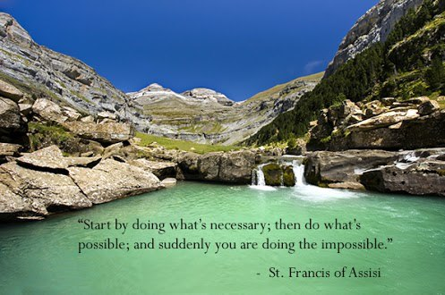
Overwhelmed?

Slide 26
So what can we do about all this?
We can pray
But do not think that is enough
We can and should do more
OK, here they go again wanting more money
Yes, but we should do more than just give money
Says who?
Can anyone tell us who?

Slide 27
You know who!
Read:
  Your Bible
  Rules 13-16, 18-19 and the General Constitutions arts 15, 18, 19, 21, 22, 23.
  the newspapers, watch the news, google

Slide 28

Inform yourself, share information
Franciscan Intellectual Tradition
Notes:
This job is too big for me I need help

Slide 29

Become aware and be:
Francis: “Let us begin, brothers, to serve the Lord God, for up until now we have done little or nothing!”
(1 Cel 103).

Slide 30
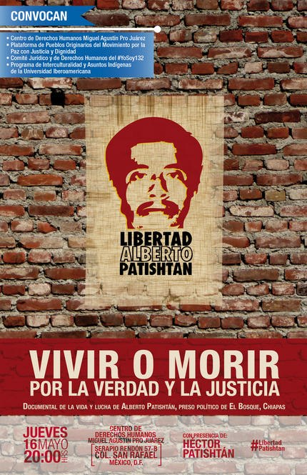
peoples lives are at stake
Notes:
Alberto Patishtán, is an elementary school teacher and social activist snatched from his Tsotsil hometown, El Bosque. He was also a community organizer in the indigenous community of El Bosque in Chiapas, was framed in the killing of 8 police, and faces 60 years in prison. The emblematic political prisoner of Mexico was returned in 2012 to the prison known as CERSS No. 5 in San Cristóbal de las Casas, Chiapas. The government finally abided by the ruling issued on July 13 by the judge in the court at Tuxtla Gutiérrez, granting a protective order sought by the Fray Bartolomé de las Casas Center for Human Rights on the basis that Albert’s transfer to the maximum security prison at Guasave, Sinaloa was unacceptable. See video subtitled in English: http://youtu.be/Lj0lUahDzTs

Slide 31
Is it time to have another fraternity discussion?
I will now show some clips or slides and try to restrain myself from comment.
But you are encouraged to speak
Do not worry if there is disagreement. As Franciscans we are tolerant and love diversity! We learn from each other and agree to disagree if necessary

Slide 32
Income inequality
Global Wealth Inequality - What you never knew you never knew (3:50 mins)
http://www.youtube.com/watch?v=uWSxzjyMNpU
Who makes the rules?
Do the rules need to be changed?
How do we change them?
How do we combat:
  greed, apathy, denial & ignorance?
  Government & media complicity & collusion?
  Resentment of protest?
Notes:
Jason Hickel writes, narrates and directs this short video looking at the extreme truth of how wealth is divided globally, for Global Policy Journal.
Wealthiest one percent own half of the globe's assets.
from The Tyee
Eric Zuesse, writing for AlterNet.org and The Tyee, reviews a preliminary report of Branko Milanovic, lead research economist at the World Bank. Milanovic finds "global inequality is much greater than inequality within any individual country" because the inequality between countries adds to the inequality within any one of them. The gap in wealth is even larger than the gap in annual income, he says, with the wealthiest one percent forming an extremely exclusive global club of the "old rich."

Slide 33
Simple, maybe trite, but nevertheless true:
“The world has enough for everyone's need,
but not enough
for everyone's greed.”
Mahatma Gandhi

Slide 34
One effect of the rules
Robert Fox, Executive Director, Oxfam Canada: "For every dollar we give in aid two are stolen through unfair trade … The G8 countries have rigged trade rules, blocking trade's potential to wipe out poverty and instead increasing the global wealth divide.”
Molly Kane, Advocacy and Research Officer, Canadian Catholic Organization for Development and Peace: “$130 billion is given in yearly aid, but$2 trillion goes back to the wealthy countries in payments, tariffs, etc.”

Slide 35
How are the rules made?
One theory is on the next slide
Take a close look, then ask yourself is it
True?
Does it contain some truth?
Or is it just a crackpot conspiracy theory?
OK, so how are the rules made?

Slide 36
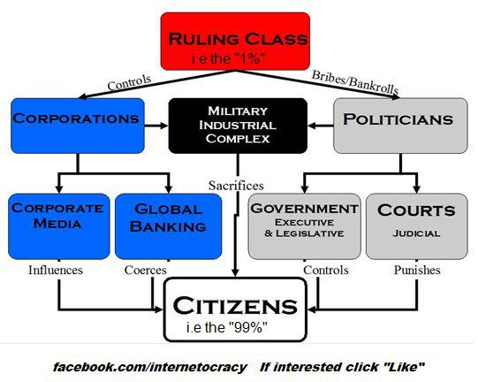

Slide 37
Who does the law benefit?
"The law is like a snake, it bites
just the barefooted...!”
Archbishop Oscar Arnulfo Romero
Vatican official says Archbishop Romero's sainthood cause 'unblocked'

Slide 38
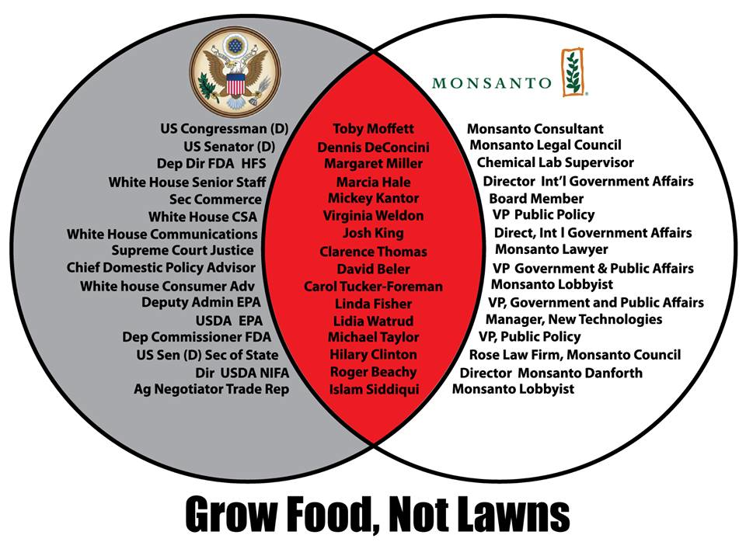
Notes:
Business and government: a close fit. One US example

Slide 39
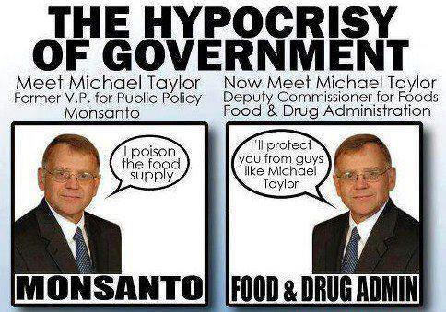

Slide 40
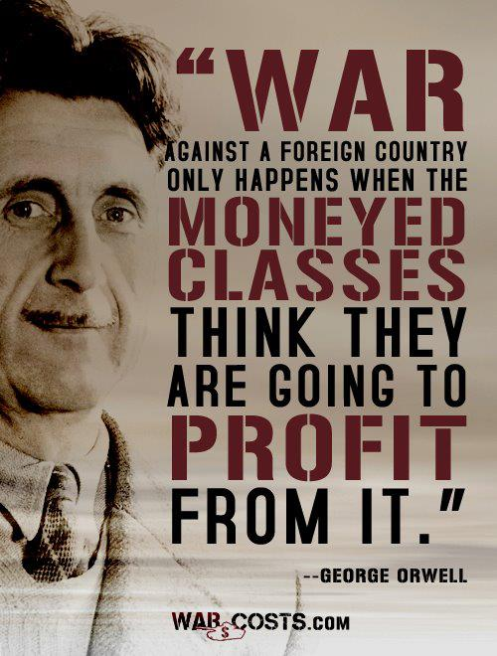
Who stands to gain financially from war and unrest in the Middle East?
Oil exporters. The more war looms, the higher the premium they fetch.
Who are they?
Russia, Iran, Saudi Arabia, Qatar, Venezuela and …..*
Notes:
*The oil war dividends
Lawrence Solomon | 13/05/30

Slide 41
ANOTHER EXAMPLE - TAXES
Offshore bank accounts are legal
They exist to avoid taxes
Apple repatriated $30 billion in profits from Ireland and paid no taxes*
Income tax is hugely unfair, increasingly shifting the national tax burden onto the wage-earning middle classes … in 1945 corporations paid 47% of total US income tax, today its 19% and falling.*
Individuals contribution rose from 53% to 81%.*
Who makes the rules, and for whose benefit?
Who cares? Oh, wait:
What about the preferential option for the poor?
Notes:
*Vancouver Sun 24 May 2013 Robert Mcgarvey

Slide 42
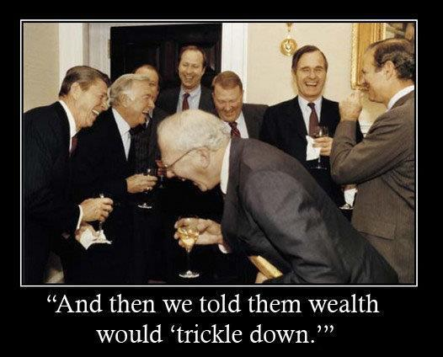

Slide 43
“The price of apathy towards public affairs is to be ruled by evil men.” (Plato)
“What good fortune for governments that the people do not think.” & “What luck for rulers that men do not think.” (Adolf Hitler)
“The world is a dangerous place, not because of those who do evil, but because of those who look on and do nothing.” (Albert Einstein).

Slide 44
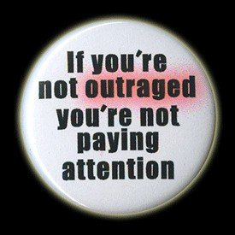

Slide 45
Is this why?
⬇

Slide 46
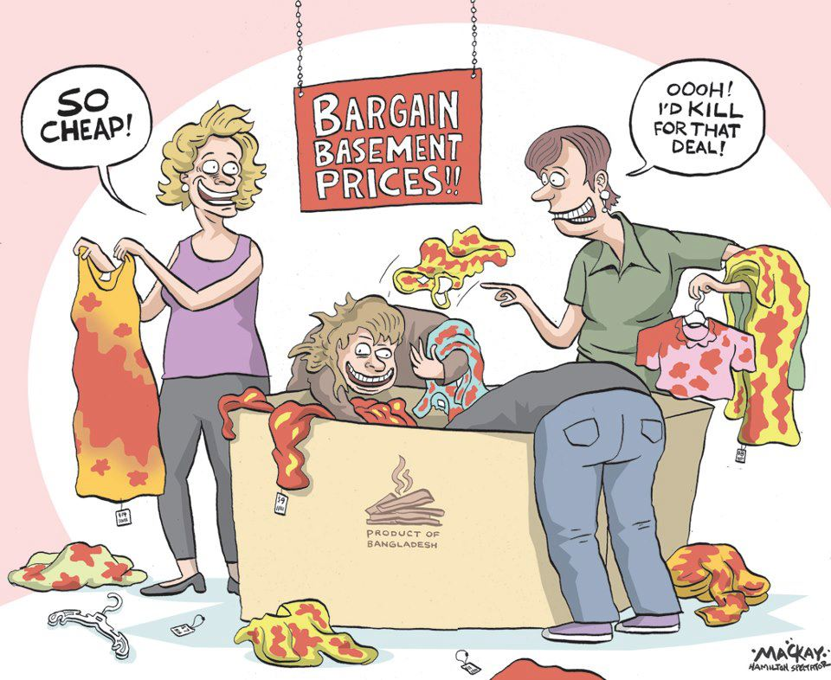

Slide 47
Pope Francis on fair trade
"Not paying fairly, not giving a job because you are only looking at balance sheets, only looking at how to make a profit. That goes against God!”

Slide 48
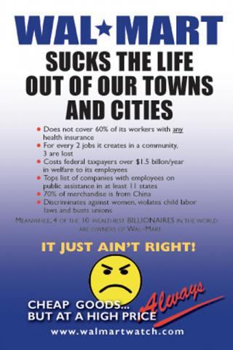

Slide 49
SO GLAD CANADIANS ARE NOT LIKE THAT! REALLY? DO NOT GET SMUG!
Canadian mining companies are a major force worldwide and their human rights and environmental reputation is too often very bad
Canadian mining companies subject of worldwide protests
Citizen's groups in at least 10 countries complaining about gold and silver miners' environmental practices
e.g. on 21 March 2013, Catholic priests marched with 5,000 locals in Matagalpa, Nicaragua, against a project owned by Vancouver-based B2Gold Corp.
Notes:
By Santiago Ortega Arango, special to CBC News Posted: Apr 3, 2013 5:21 AM ET Last Updated: Apr 3, 2013 1:25 PM ET

Slide 50
Who makes the rules?
Bill C-300, a private members bill tabled by Liberal Member of Parliament John McKay, proposed giving the government authority to investigate complaints against resources companies operating abroad, and withholding public money from offenders.
It would have made government political and financial support contingent on compliance.
Bill C-300, however, was defeated by six votes in a minority parliament in 2010.
Notes:
Defeated Oct 2010

Slide 51
Is our silence consent?
Ever heard of Franciscan Voice Canada?
We sign petitions & write letters and visit MP’s, MLA’s, municipal & corporate officials
Some of us protest & attend rallies and marches
Does your fraternity do this?
No ? Too political? What’s politics got to do with the church?
Don’t like signing petitions or protesting in public? (In the forefront? courageous initiatives?)

Slide 52
Political charity
Pope Pius XI spoke of "political charity" as one of the highest forms of the virtue of charity. In more recent times, the Church has told us that "a merely individualistic morality" will not suffice, and that Christians must "give an example by their sense of responsibility and their service of the common good”
(Ontario Bishops 1998)

Slide 53
Deus caritas est (Benedict XVI, 2009)
“The more we strive to secure a common good corresponding to the real needs of our neighbours, the more effectively we love them… This is the institutional path - we might also call it the political path - of charity. “(n. 7)

Slide 54
Advocacy
Advocacy is speaking up on behalf of the powerless and voiceless in society and an important strategy and tool for all kinds of charity, pro-life and JPIC social action; and was specifically called for by the XIII General Chapter of the OFS in 2011.
Advocacy is the main ministry of Franciscans International
Toronto and Vancouver RC Archdioceses do advocacy
The English and Welsh Bishops’ Caritas Social Action Network (CSAN) engages in advocacy
The Archdiocese of New York has a “Catholic Advocacy Network” to “implement the Bishops' legislative advocacy strategies … which organizes and mobilizes grassroots e-mail advocacy …”
Notes:
Lobbying!

Slide 55
Advocacy
Franciscans International
OFM Custody of the Holy Land
Franciscan Voice Canada
Canadian Catholic Organization for Development and Peace
Franciscan Action Network (USA)
Avaaz, Amnesty International, Mining Watch et al

Slide 56
Here are some people who have the courage of their convictions
They have seen, judged and then acted
They are advocates

Slide 57
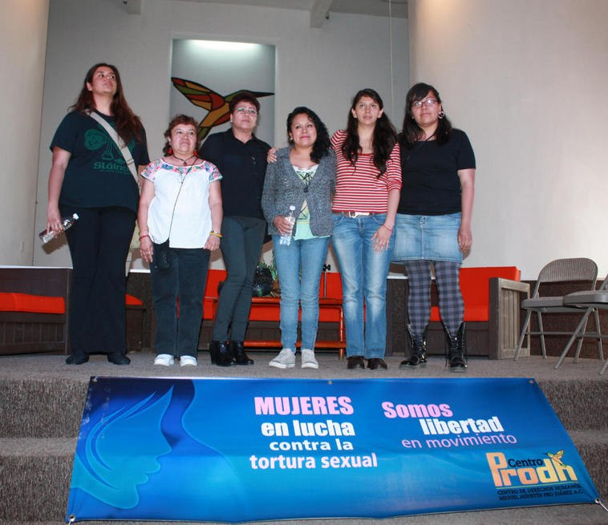
Notes:
Miguel Augustin Pro was a martyr in The Cristero War (1926–29) also known as La Cristiada, was a mass popular uprising and attempted counter-revolution against the anti-Catholicism of the ruling Mexican government. Based in western Mexico, the rebellion was set off by the enforcement of the Mexican Constitution of 1917 by former Mexican President, Freemason and atheist Plutarco Elías Calles, in order to persecute the Roman Catholic Church and its sub-organizations.

Slide 58
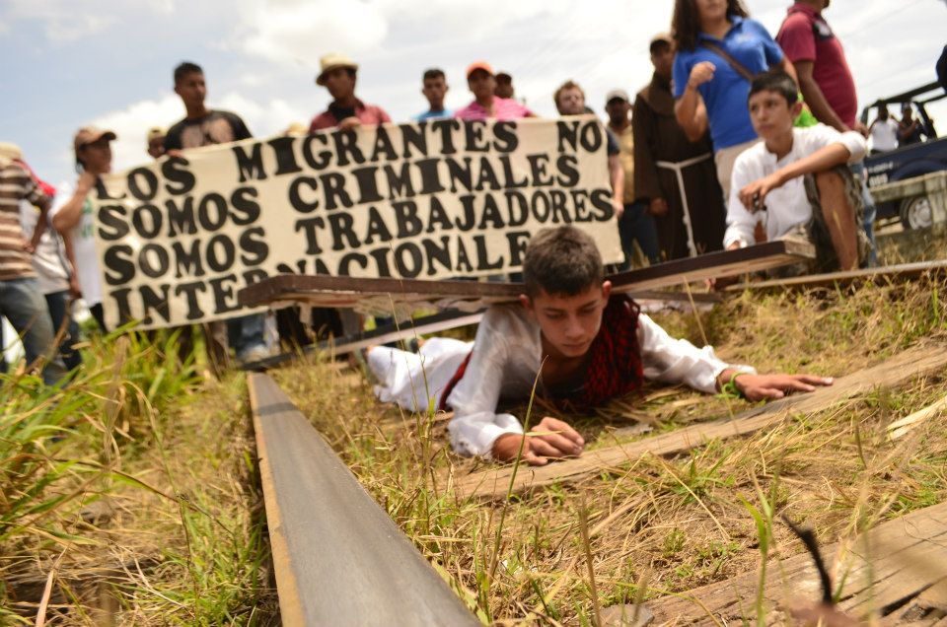
Notes:
NOTE THE FRIAR IN THE BACKGROUND.THIS IS A WAY OF THE CROSS - SEE THE CROSS ON THE BOY’S BACK?

Slide 59
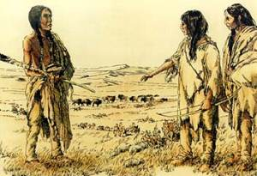
Illegal immigration?
Are you related to these people?
Courtesy of Head-Smashed-In Buffalo Jump

Slide 60
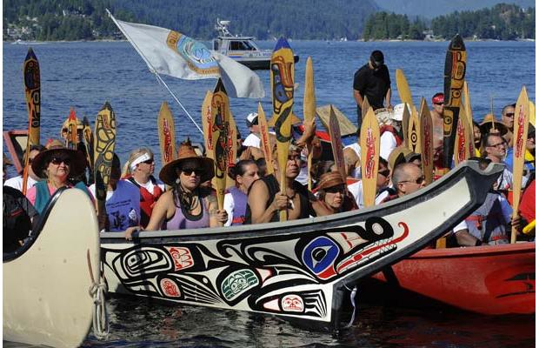
Or these people? They are demonstrating against possible increased oil tanker traffic
Notes:
IF NOT, THEN SHUT UP?

Slide 61
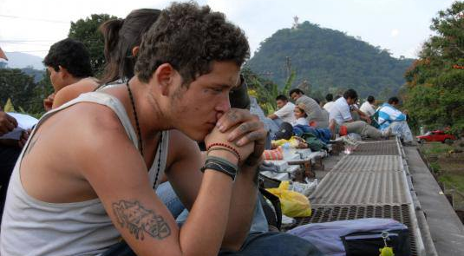
Migrants on a train

Slide 62
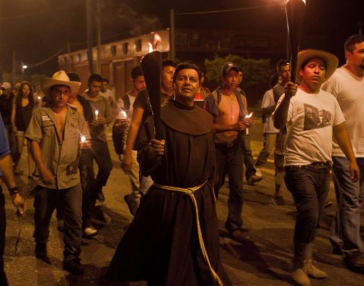
Notes:
Fray Tomás González, Director del Hogar-Refugio para Personas Migrantes La “72”, de Tenosique, Tabasco, y
Rubén Figueroa del Movimiento Migrante Mesoamericano

Slide 63
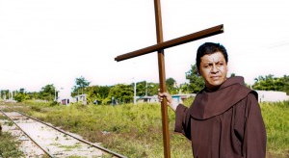
Fray Tomás González, Director del Hogar-Refugio para Personas Migrantes La “72”, de Tenosique, Tabasco

Slide 64
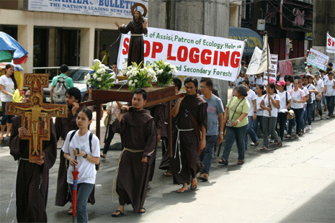
Quezon City, Philippines, 4 October 2011

Slide 65
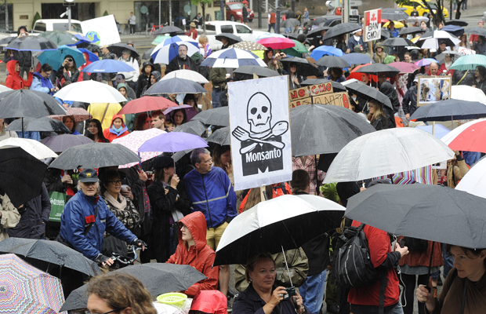
Vancouver, BC, 25 May 2013. Two million people
marched in rallies in 436 cities in 52 countries.
Notes:
ANDREW WAS THERE

Slide 66
What was it about?
Anybody know why two million marched?
Bet you did not read about the march in the National Post
I wonder why?
Maybe next year or the year after?

Slide 67
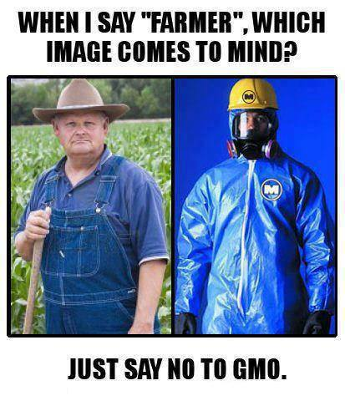

Slide 68

Shall
we
sing?

Slide 69
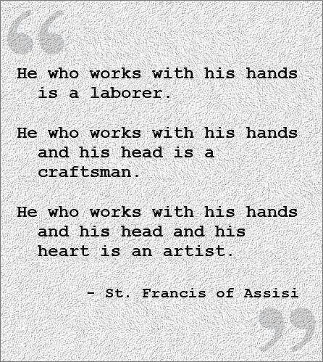
Ingrid Cruz
is an artist

Slide 70
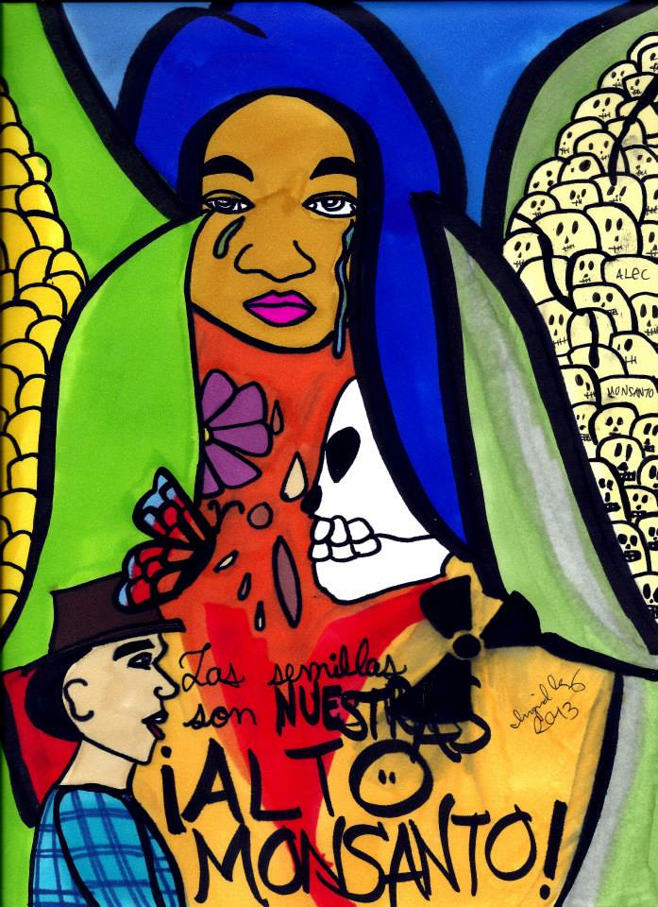
The seeds are ours
Stop Monsanto!
“Greed kills”
Ingrid Cruz
Artist
Madre Tierra,
Pachamama,
Mother Earth
Notes:
La Via Campesina, which represents more than 200 million farmers, workers, and activists all over the world, is a powerful symbol of resistance against Monsanto and the domination of agricultural production by the interests of industrial and finance capital.
This weekend’s marches against Monsanto were a wonderful demonstration of the popular anger over the monopolization of agriculture by corporate interests.
http://rt.com/op-edge/march-monsanto-gmo-future-820/

Slide 71
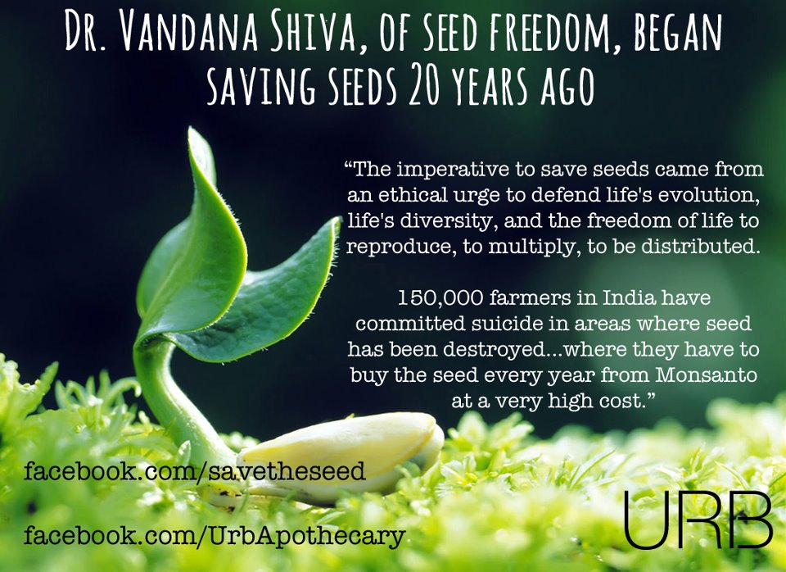
Notes:
Monsanto is a criminal corporation?

Slide 72
New York Times, 26 May 2013
“The concentration of carbon dioxide in the earth’s atmosphere recently surpassed 400 parts per million for the first time in three million years. If you are not frightened by this fact, then you are ignoring or denying science. Relentlessly rising greenhouse-gas emissions, and the fear that the earth might enter a climate emergency from which there would be no return, have prompted many climate scientists to conclude … .”
Notes:
Clive Hamilton

Slide 73
What is Avaaz?
“Experts say the $1 trillion we give away to the Exxons and BPs of the world is enough to kickstart a clean energy revolution to replace all fossil fuels with renewables. It’s unbelievable to imagine and yet it is totally tangible and viable -- the funds are there and moving them over to green energy just depends on political will.”
Ending fossil fuel subsidies is 'no-brainer' says former Tory MP (Vancouver Sun)
http://www.vancouversun.com/business/Ending+fossil+fuel+subsidies+brainer+says+former+Tory/6319323/story.html
Notes:
ONE TRILLION $ SPENT ON THERMAL OR SOLAR POWER OR RESEARCH ETC MIGHT MAKE QUITE A DIFFERENCE. WHY DO THE OIL CORPS NEED SUBSIDIES/ DON’T THEY MAKE ENOUGH PROFIT?

Slide 74
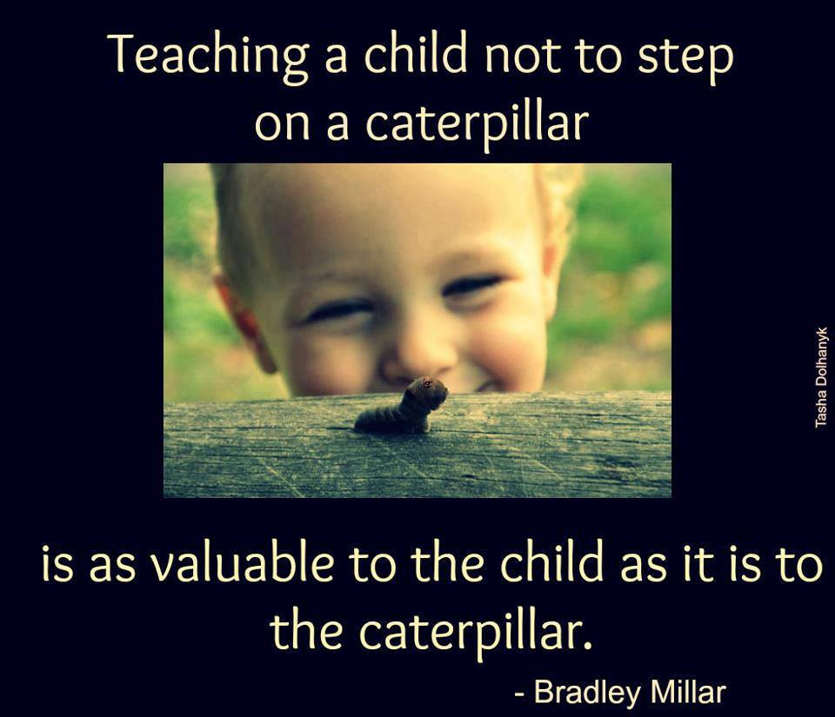

Slide 75
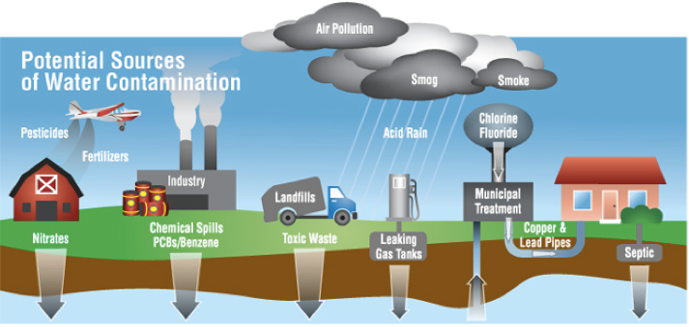
Defend Sister Water against …..
and fracking

Slide 76
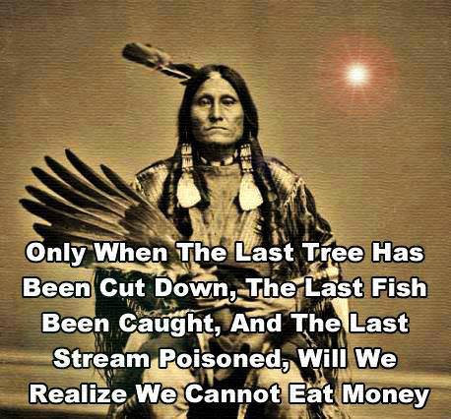
Notes:
Attributed to Alanis Obomsawin, an Abenaki from the Odanak reserve, seventy odd miles northeast of Montreal in a
collection of essays published in 1972 titled “Who is the Chairman of This Meeting?”

Slide 77
Among the conclusions of the XIII General Chapter of the OFS in 2011 were:
“Franciscans must be agents of social transformation.” (n.1.1) and
“Since "the lay faithful are never to relinquish their participation in ‘politics’" (Christifideles Laici, 42), it is necessary to underline the importance of political education for citizen advocacy, based on the social doctrine of the Church. This Chapter urges OFS Councils, at all levels, to organize regular political education classes that will help members to acquire the skills necessary to respond without delay to what the church asks of us at this time.” (n.4, emphasis added).

Slide 78
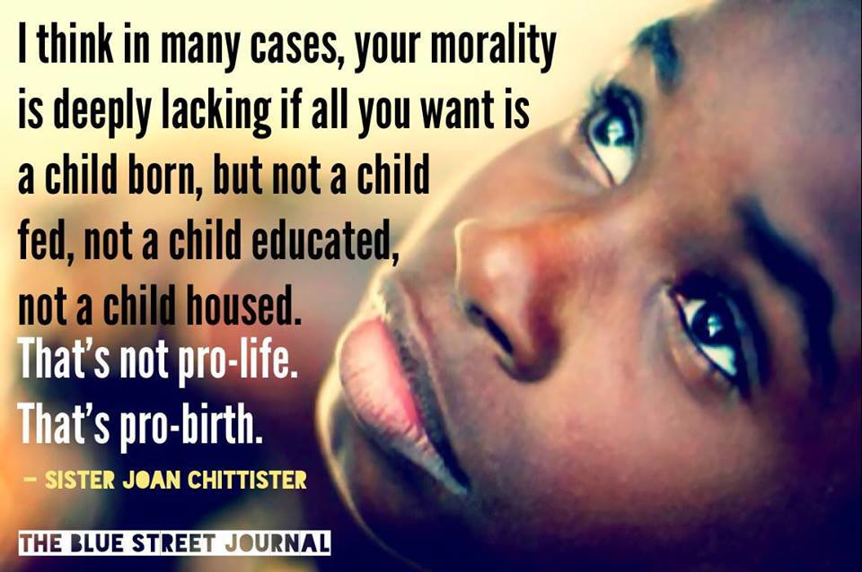

Slide 79
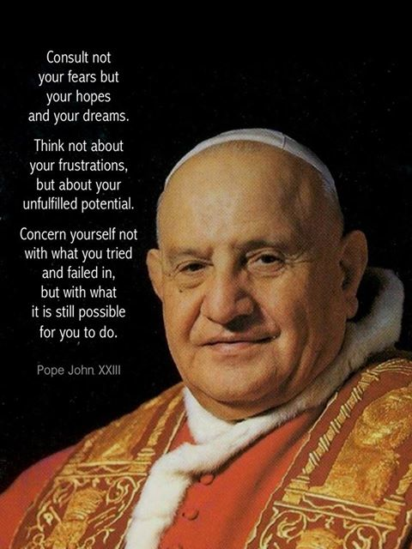

Slide 80
Benet Fonck, OFM
1995, Fully Mature with the Fullness of Christ
“The person with a secular vocation and a lay mission is meant to “build a more fraternal and evangelical world” by being a subversive, revolutionary force within society, causing from within a whole transformation of values and attitudes. It is the task of the secular lay person to infiltrate the world with gospel values, to change it from within, and to direct it toward union or reconciliation with God the Father through Jesus Christ.” (p 12-14, emphasis added)

Slide 81
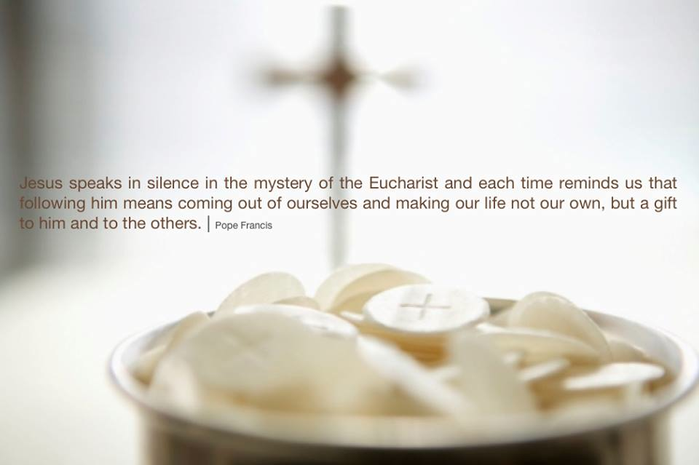
Corpus Christi, 2013

Slide 82
From gospel to life
“But be doers of the word, and not hearers only, deceiving yourselves.” Jas 1:22
“I by my works will show you my faith.”
Jas 2:18
“Little children, let us stop
just saying we love people,
let us really love them,
and show it by our actions.” 1 Jn 3:18

Slide 83
We have touched on a few of the National Plan JPIC issues
NOW WHAT?
NOW YOU KNOW
Will you discuss these issues with your fraternity?
Will you make your voice heard?

Slide 84
In summary
Please:
Complete and return the questionnaire
Consider the National JPIC plan’s issues
Use Fair Trade groceries in your meetings
Consider advocacy
Consider using Understanding JPIC in formation
THANKS FOR YOUR ATTENTION AND INTEREST
Peace, joy and all good!

